Slide 1


„Robotics in India” Intelligent Robot - Remote Car project
by Bartłomiej Borzyszkowski (Poland) Gdansk University of Technology (ETI) Karunya Institute of Technology and Sciences (ET)

Slide 2






„Robotics in India” – Intelligent Robot project by Bartłomiej Borzyszkowski
About the author
Bartłomiej Borzyszkowski
Control Engineering and Robotics (BSc) student (ETI) at Gdansk University of Technology, Poland.
Scientific intern with the IAESTE program at Karunya Institute of Technology and Sciences, Coimbatore - India.
Gradient Science Club - artificial intelligence developer.
IAESTE Poland IT Coordinator and Job Raising member.

Slide 3

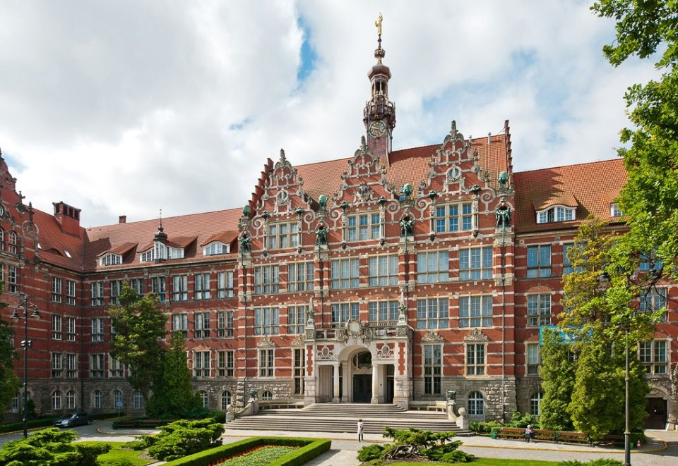
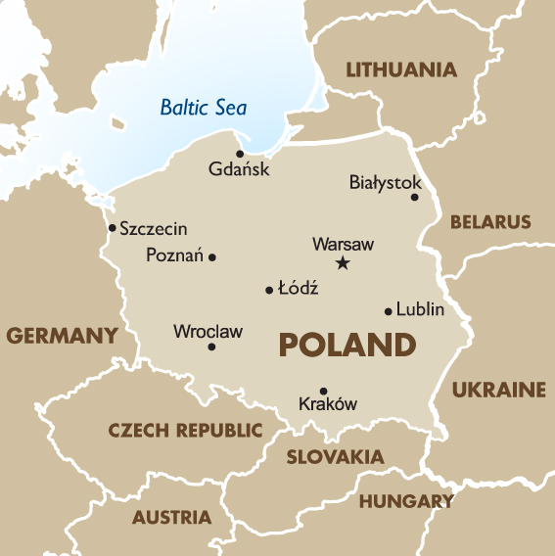
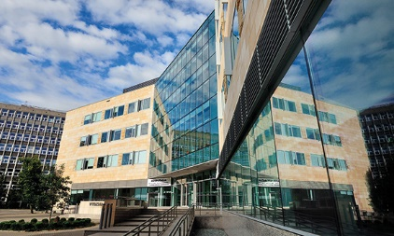
„Robotics in India” – Intelligent Robot project by Bartłomiej Borzyszkowski
Gdańsk and Technology

Slide 4
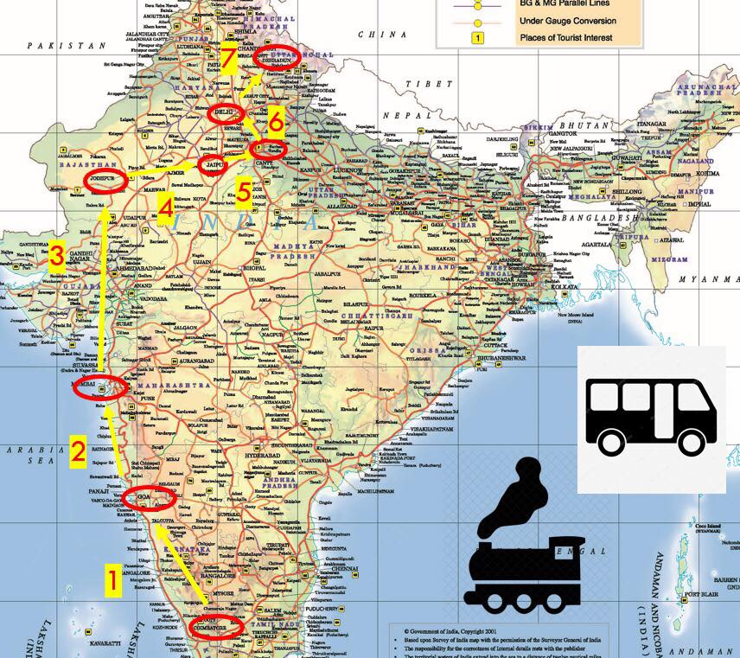
„Robotics in India” – Intelligent Robot project by Bartłomiej Borzyszkowski
Project introduction
8 week internship at the Karunya Electrical Department under the supervision of Dr. K. Rajasekaran with an assistance of Mr. J. Chinnadurai.
Creating and developing of the intelligent robot, remote/self-driving car.
Cooperation in the international engineering team.
Besides the work:
Over 3 week travel adventure including: Goa, Mumbai, Jodhpur, Jaipur, Delhi, Agra, Haridwar, Rishikesh, Ganges, Himalayas.
Exploration of India, discovery of the rich culture, unique cuisine, wild nature and diverse environment of the country.

Slide 5
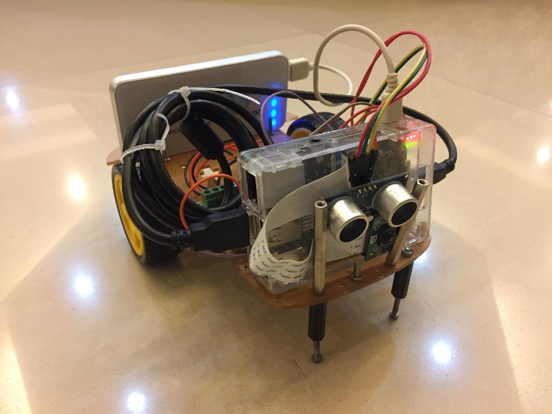
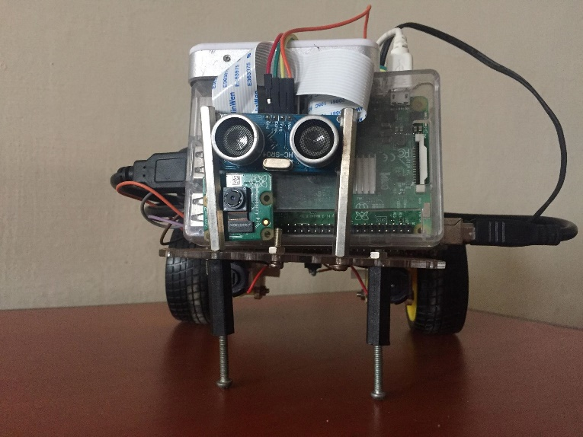
„Robotics in India” – Intelligent Robot project by Bartłomiej Borzyszkowski
Project introduction
GitHub repository:
github.com/Borzyszkowski/Robotics-in-India-Intelligent-Robot
Crowdfunding campaigns and the full internship description:
zrzutka.pl/robotics (Polish)
youcaring.com/robotics (English)

Slide 6
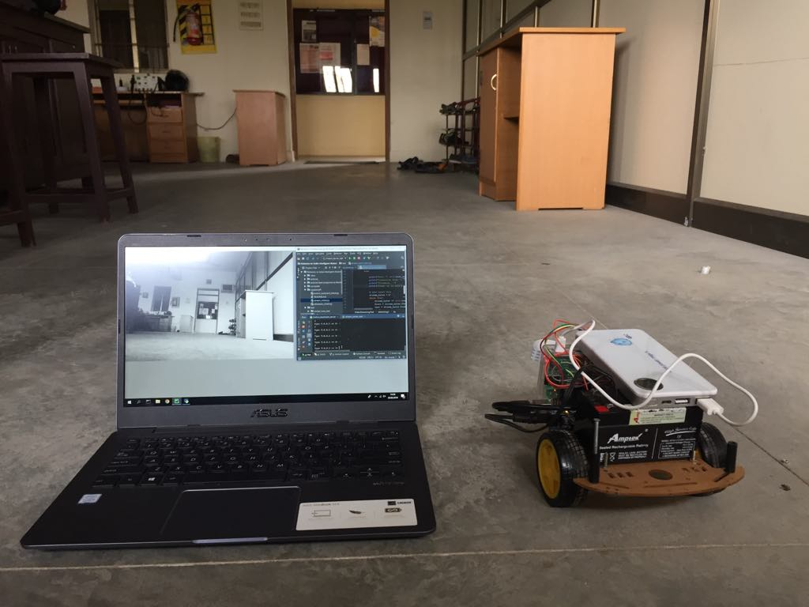
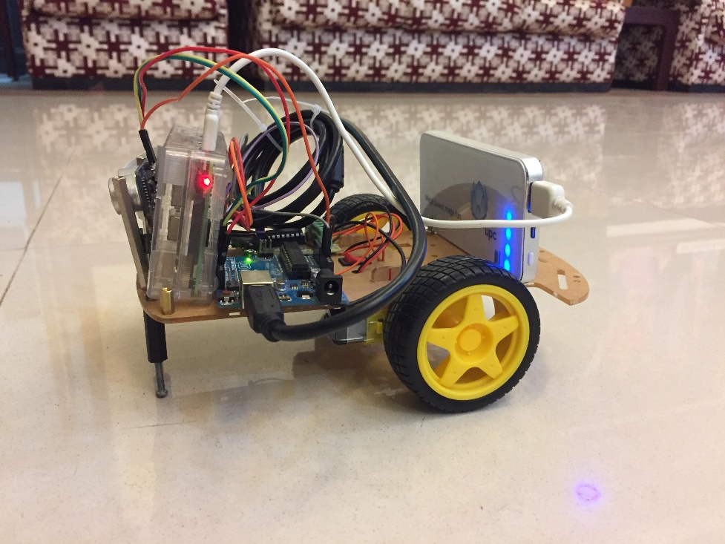
„Robotics in India” – Intelligent Robot project by Bartłomiej Borzyszkowski
Robot overview

Slide 7
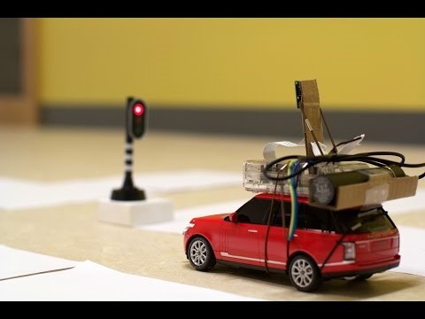
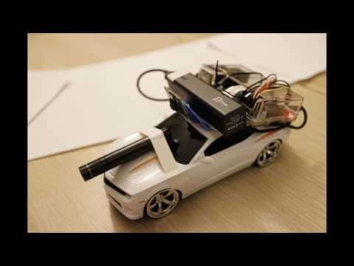
„Robotics in India” – Intelligent Robot project by Bartłomiej Borzyszkowski
Inspiration
Zheng Wang Auto RC Car:
github.com/hamuchiwa/AutoRCCar
zhengludwig.wordpress.com/projects/self-driving-rc-car/

Slide 8
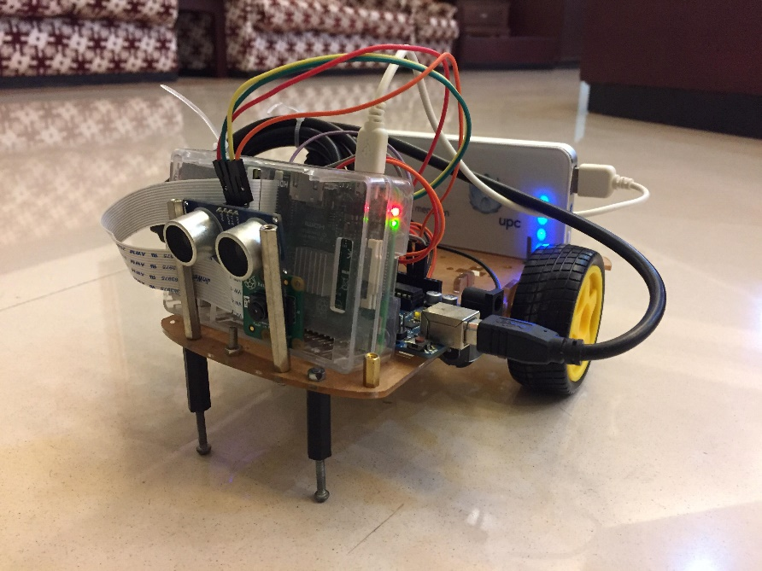
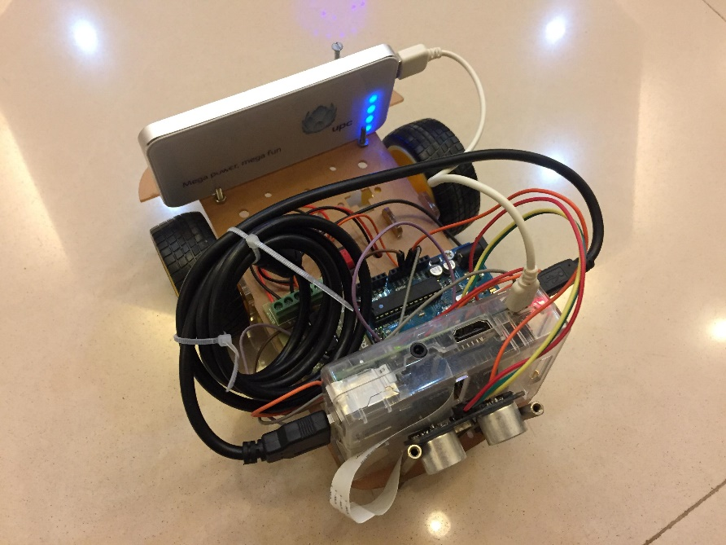
„Robotics in India” – Intelligent Robot project by Bartłomiej Borzyszkowski
Functionality overview
Remote control using laptop keyboard
Camera display on the laptop
Distance measurement thanks to ultrasonic sensor
Steering (Forward, Backward, Right, Left, Stop)

Slide 9
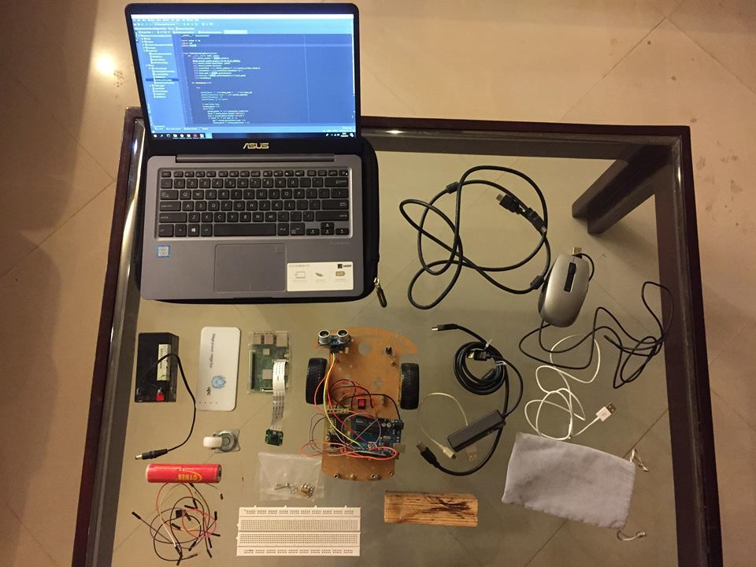
„Robotics in India” – Intelligent Robot project by Bartłomiej Borzyszkowski
Construction details - components
Project elements:
Raspberry Pi 3 Model B
Pi Camera desired for Raspberry Pi
Arduino UNO
Laptop/PC
Ultrasonic sensor HC-SR04
Motor driver L293
2 separate motors and 2 wheels
Power supply (Power Bank)
Robot board – car frame
Cords/wires
Soldering equipement
Wi-Fi network
External display
Programming environment and software

Slide 10
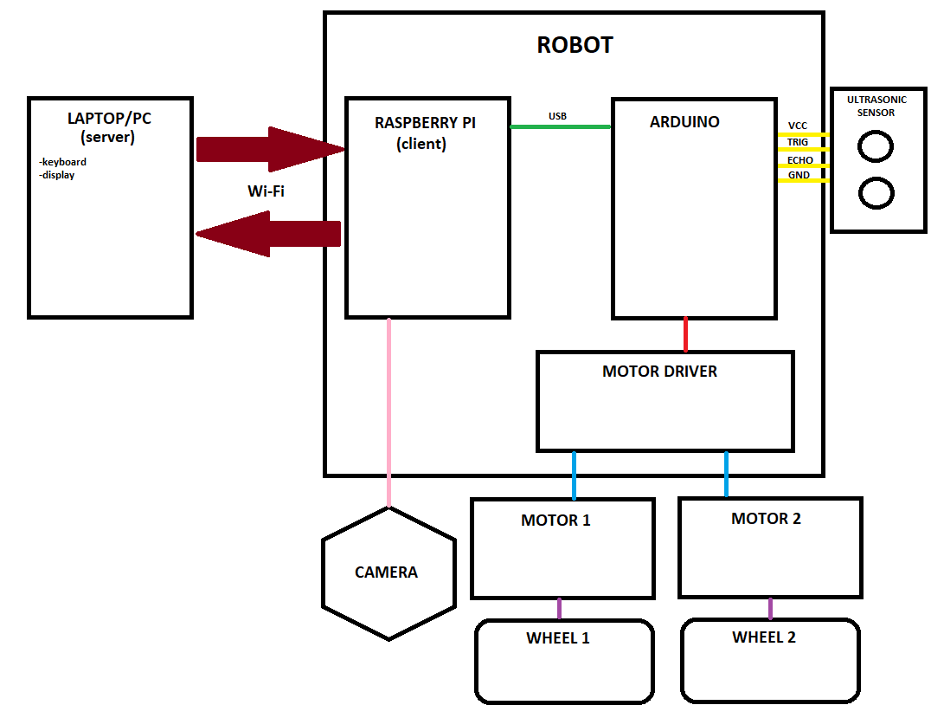
„Robotics in India” – Intelligent Robot project by Bartłomiej Borzyszkowski
Construction details - architecture

Slide 12
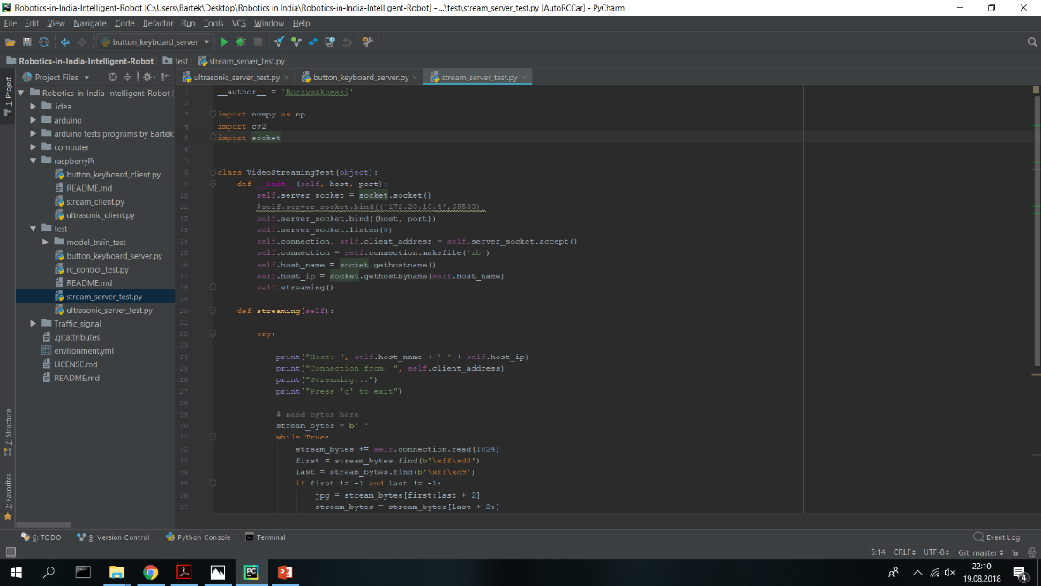
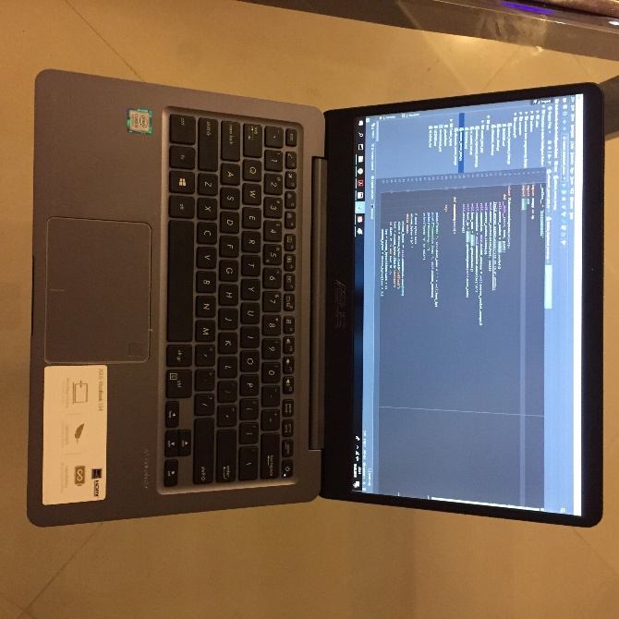
„Robotics in India” – Intelligent Robot project by Bartłomiej Borzyszkowski
Construction details - Computer
Computer – laptop/PC:
Working as a server for Raspberry Pi (client) via Wi-Fi
Collecting information about steering from the keyboard and forwarding it to the Raspberry Pi
Receiving video from the Raspberry Pi and showing the display

Slide 13
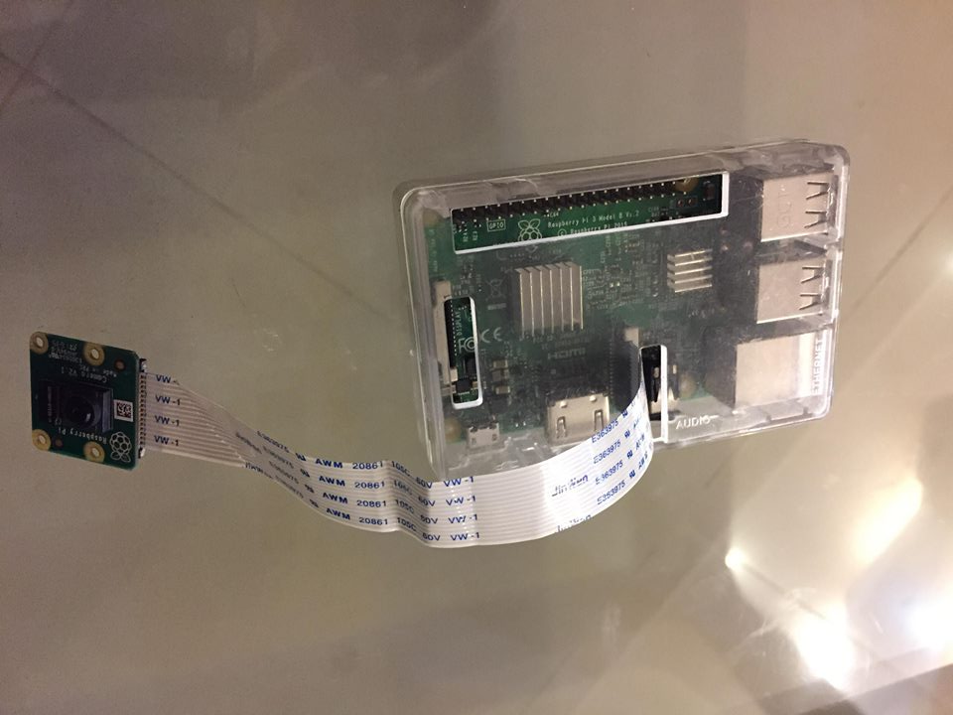
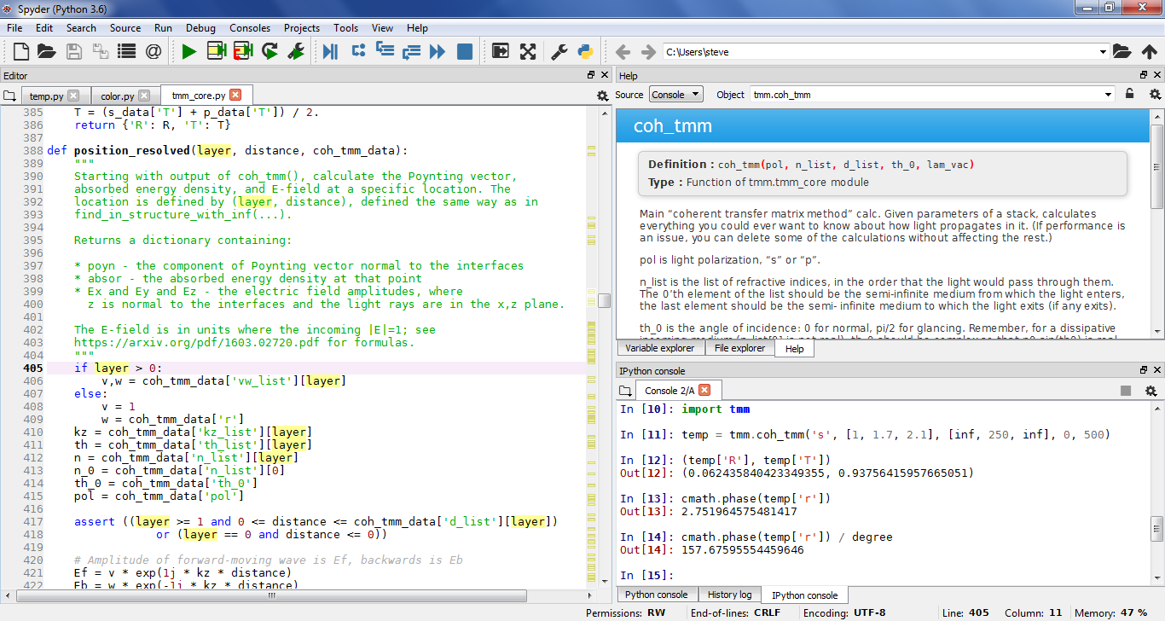
„Robotics in India” – Intelligent Robot project by Bartłomiej Borzyszkowski
Construction details – Raspberry Pi
Raspberry Pi:
Working as a client for the computer (server) via Wi-Fi
Connected to the Arduino via USB
Connected with Pi camera
Collecting information about steering from the computer (keyboard) and forwarding it to the Arduino
Collecting data from the camera and sending it to the computer

Slide 14
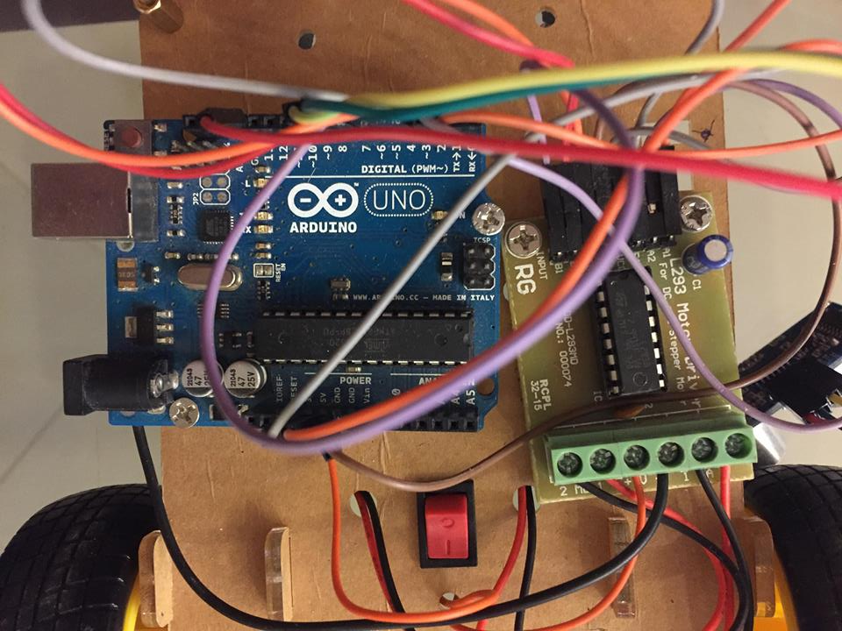
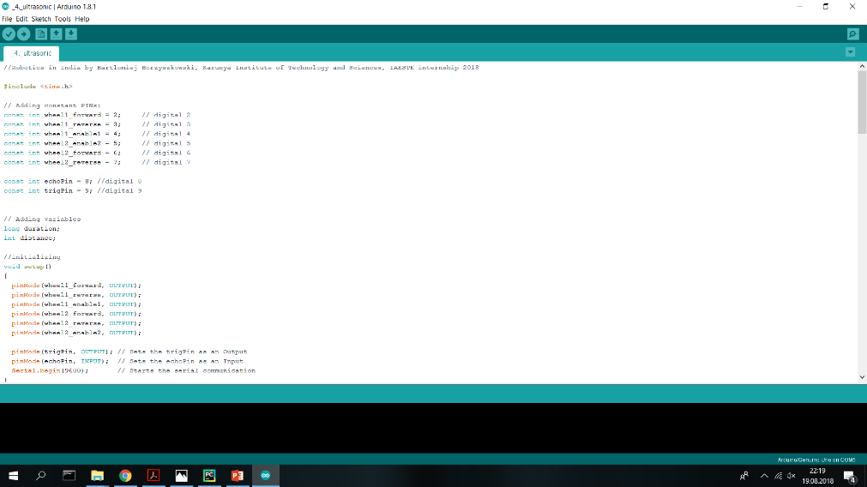
„Robotics in India” – Intelligent Robot project by Bartłomiej Borzyszkowski
Construction details - Arduino
Arduino:
Connected to the Raspberry Pi via USB
Connected to the Motor Driver
Connected to the ultrasonic sensor
Receiving data for steering from the Raspberry Pi and forwarding information to the Motor Driver
Receiving distance from the ultrasonic sensor and stopping the car in case of obstracle detection (front)

Slide 15
„Robotics in India” – Intelligent Robot project by Bartłomiej Borzyszkowski
Actual effect

Slide 16
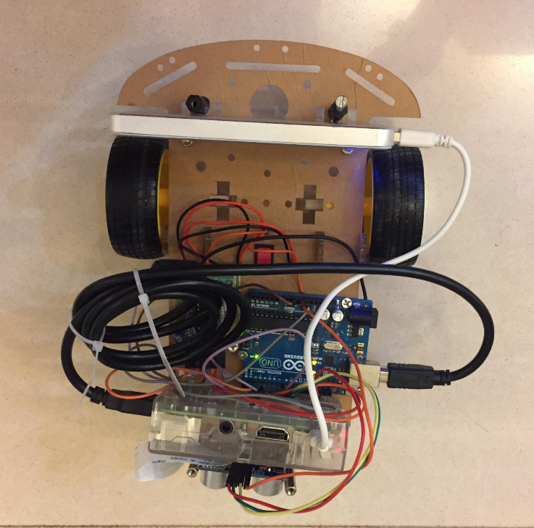
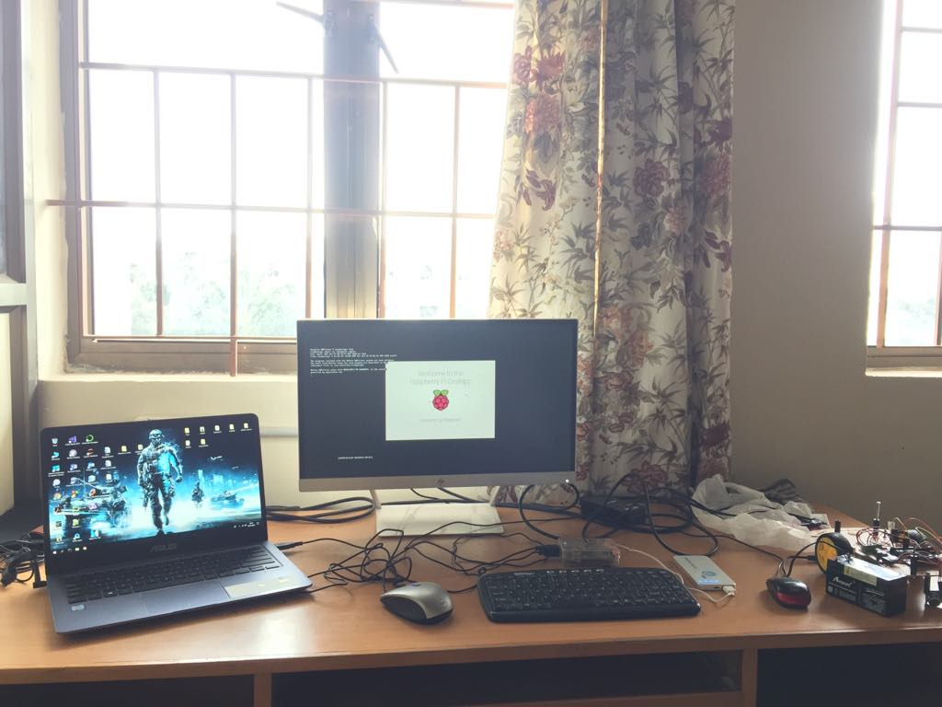
„Robotics in India” – Intelligent Robot project by Bartłomiej Borzyszkowski
Difficulties
Real time data transfer
Camera video streaming delay (scaling down the resolution is required)
Multi-level architecture
Low efficiency of Raspberry Pi core (very slow processor)
Complex software (big numer of programs)
Despite difficulties the robot works!

Slide 17
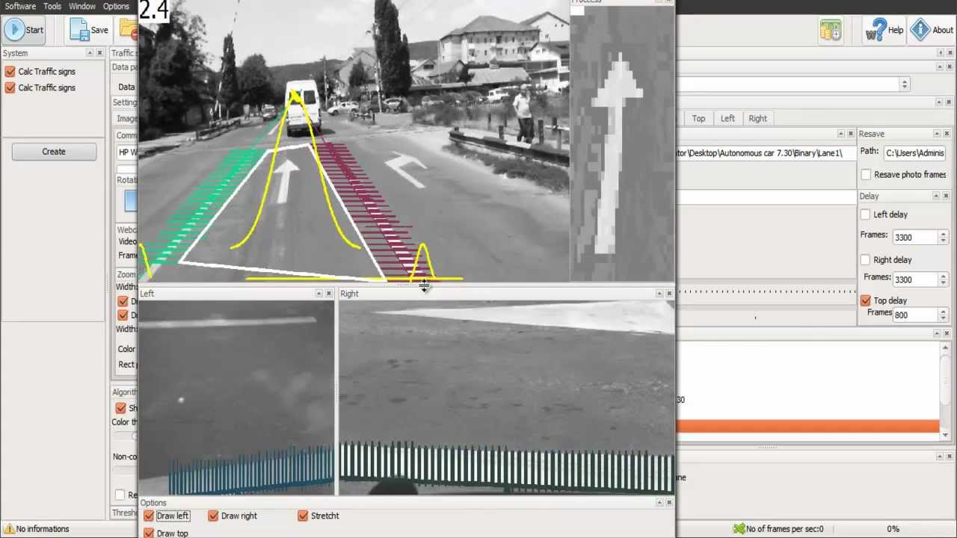
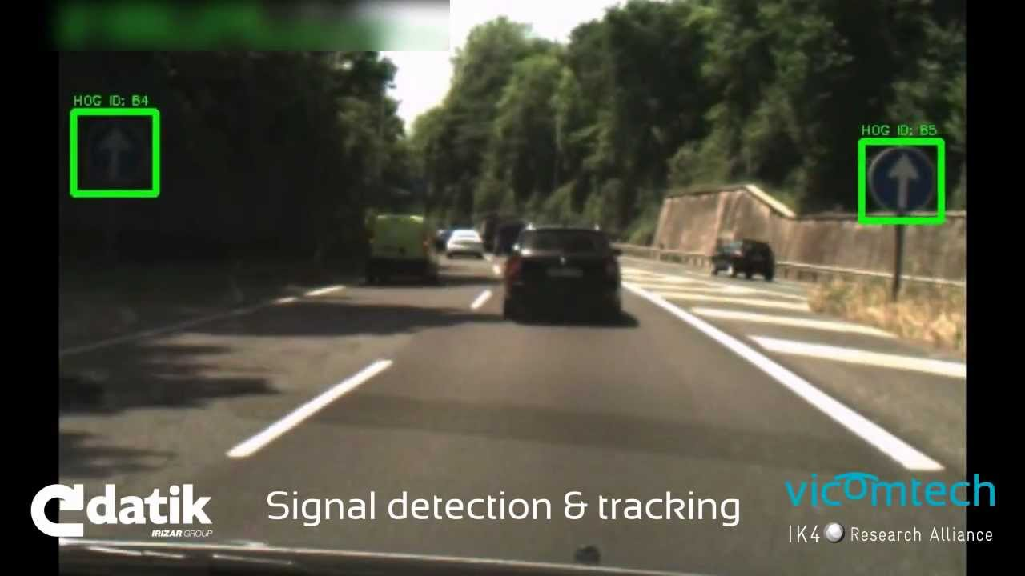
„Robotics in India” – Intelligent Robot project by Bartłomiej Borzyszkowski
Further Develop
Total autonomous
Artificial intelligence, neural networks and image processing
Road lines, signs and traffic lights recognition
More advance steering
Both kinds of control (self-drive and remote control) with balanced priorities

Slide 18
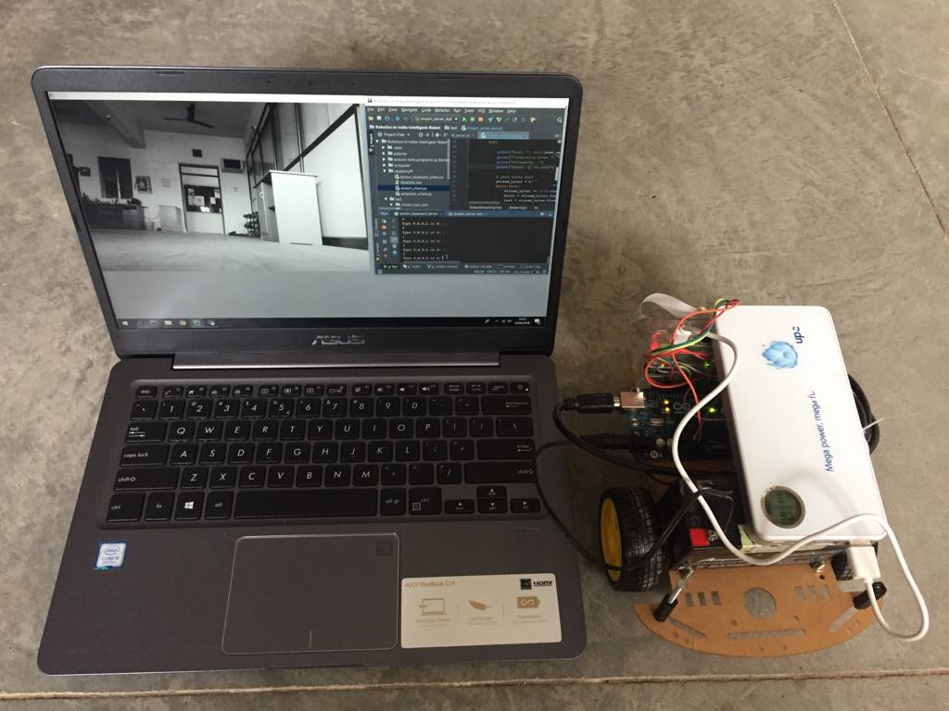
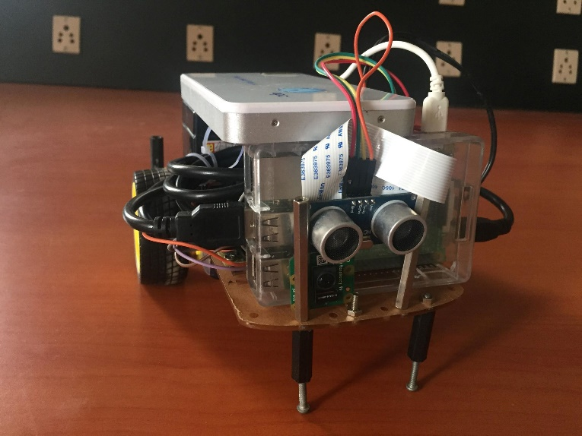
„Robotics in India” – Intelligent Robot project by Bartłomiej Borzyszkowski
Project sum up
GitHub repository:
github.com/Borzyszkowski/Robotics-in-India-Intelligent-Robot
Crowdfunding campaigns and full internship description:
zrzutka.pl/robotics (Polish)
youcaring.com/robotics (English)

